Slide 1

Hypervisor and XEN
SSN College of Engineering
Reference: Distributed and Cloud Computing K. Hwang, G. Fox and J. Dongarra

Slide 2
Overview
Hypervisor
Types of Hypervisor
Xen Architecture
Interview Questions

Slide 3
Hypervisor
A hypervisor is a hardware virtualization technique allowing multiple operating systems, called guests to run on a host machine. This is also called the Virtual Machine Monitor (VMM).
A hypervisor or virtual machine monitor ( VMM ) is a piece of computer software , firmware or hardware that creates and runs virtual machines.
Two types of Hypervisors
Bare-Metal Hypervisor
Hosted Hypervisor

Slide 4
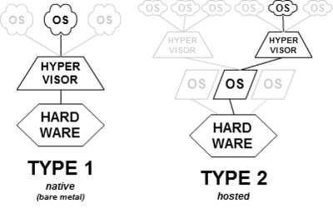

Slide 5
Hypervisor
Hypervisor provides hypercalls to the guest OSes and applications.
Depending on functionality Hypervisor can be of
Micro-Kernel Architecture
Monolithic Hypervisor Architecture

Slide 6
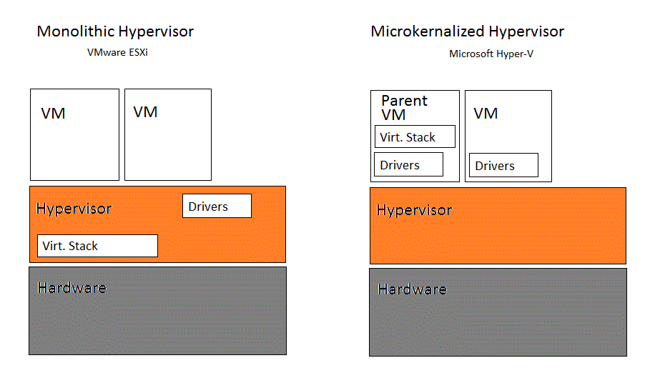

Slide 7
Hypervisor
Micro-kernel hypervisor includes only the basic and unchanging functions (such as physical memory management and processor scheduling).
The device drivers and other changeable components are outside the hypervisor.
Monolithic hypervisor implements all the aforementioned functions, including those of the device drivers.
The size of the hypervisor code of a micro-kernel hyper- visor is smaller than that of a monolithic hypervisor.

Slide 8
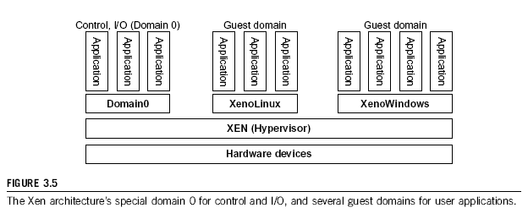
Xen Architecture

Slide 9
Xen Architecture
Xen is an open source hypervisor program developed by Cambridge University.
Xen is a micro- kernel hypervisor, which separates the policy from the mechanism.
The Xen hypervisor implements all the mechanisms, leaving the policy to be handled by Domain 0.
Xen does not include any device drivers natively.
It just provides a mechanism by which a guest OS can have direct access to the physical devices

Slide 10
Xen Architecture
The core components of a Xen system are the hypervisor, kernel, and applications.
Many guest OSes can run on top of the hypervisor.
However, not all guest OSes are created equal, and one in particular controls the others.
The guest OS, which has control ability, is called Domain 0, and the others are called Domain U.
Domain 0 is a privileged guest OS of Xen.
It is first loaded when Xen boots without any file system drivers being available.

Slide 11
Xen Architecture
Domain 0 is designed to access hardware directly and manage devices. Domain 0 is to allocate and map hardware resources for the guest domains (the Domain U domains)
Xen is based on Linux and its security level is C2.
Its management VM is named Domain 0, which has the privilege to manage other VMs implemented on the same host.
If Domain 0 is compromised, the hacker can control the entire system. So Security Policies need to be improved.

Slide 12
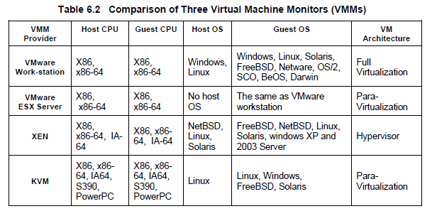
Major VMM and Hypervisor Providers

Slide 13
Summary
Hypervisor
Types of Hypervisor
Xen Architecture
Interview Questions:
https://www.javatpoint.com/cloud-computing-interview-questions

Slide 14
References
Distributed and Cloud Computing by K. Hwang, G. Fox and J. Dongarra
“OVA-open-virtualization-alliance,” https://openvirtualizationalliance.org/.
http://www.xen.org/
“Open Virtualization Format for Virtual Machines”, available at
http://www.vmware.com/appliances/getting-started/learn/ovf.html

Slide 15
THANK YOU

